Slide 1
Bitcoin Price Prediction
And Algorithm Trading Signal
Capstone Project:
Zhou Zhen Jie

Slide 2
Introduction
Bitcoin was invented in 2008 by an unknown person or a group of people using the name Satoshi Nakamoto
It is a decentralized digital currency, without a central bank or single administrator, that can be sent to anyone on the Bitcoin network.
Bitcoin have limited supply, capped by mathematical algorithm which make it impossible for anyone to dilute it’s value through inflation.
Currently Bitcoin are dominate by speculative trading and it’s demand is more than supply, which impacts price and increases volatility.

Slide 3
Problem Statement
After the all-time high of Bitcoin with a market capitalization of more than 1,000 Billion dollars in April 2021 and in October 2021 . Bitcoin is on the downward trend as of today.
Last year, Cathie wood predicted that the value of bitcoin would rise to $500,000 in 5 years. Many people include me want to know whether can we invest in bitcoin.

Slide 4
Strategy
Adding technical indicators into the dataset
Use various regression machine learning model to predict the prices
Evaluate the different model using RMSE, MAE and MAPE
Using momentum indicators like Moving Average Convergence Divergence (MACD) as algorithm for my trading prediction.
Disclaimer: This presentation’s sole purpose is to educate people and must be considered as an information piece but not as investment advice .

Slide 5
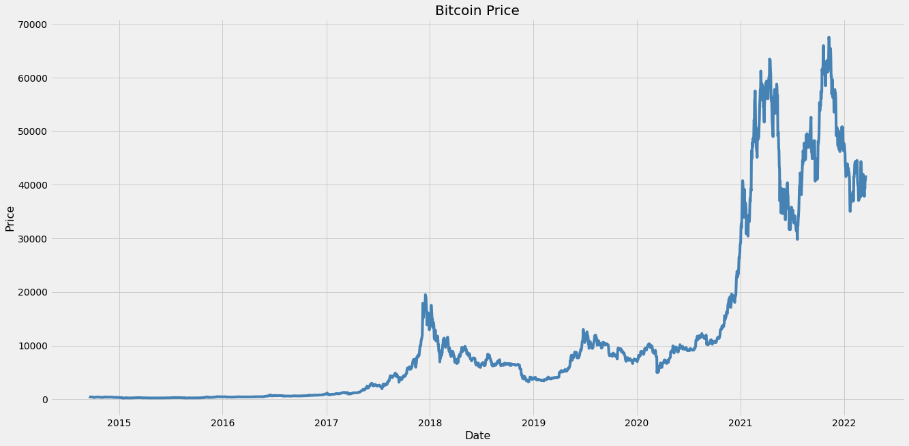
Bitcoin Closing Price Chart (8years)

Slide 6
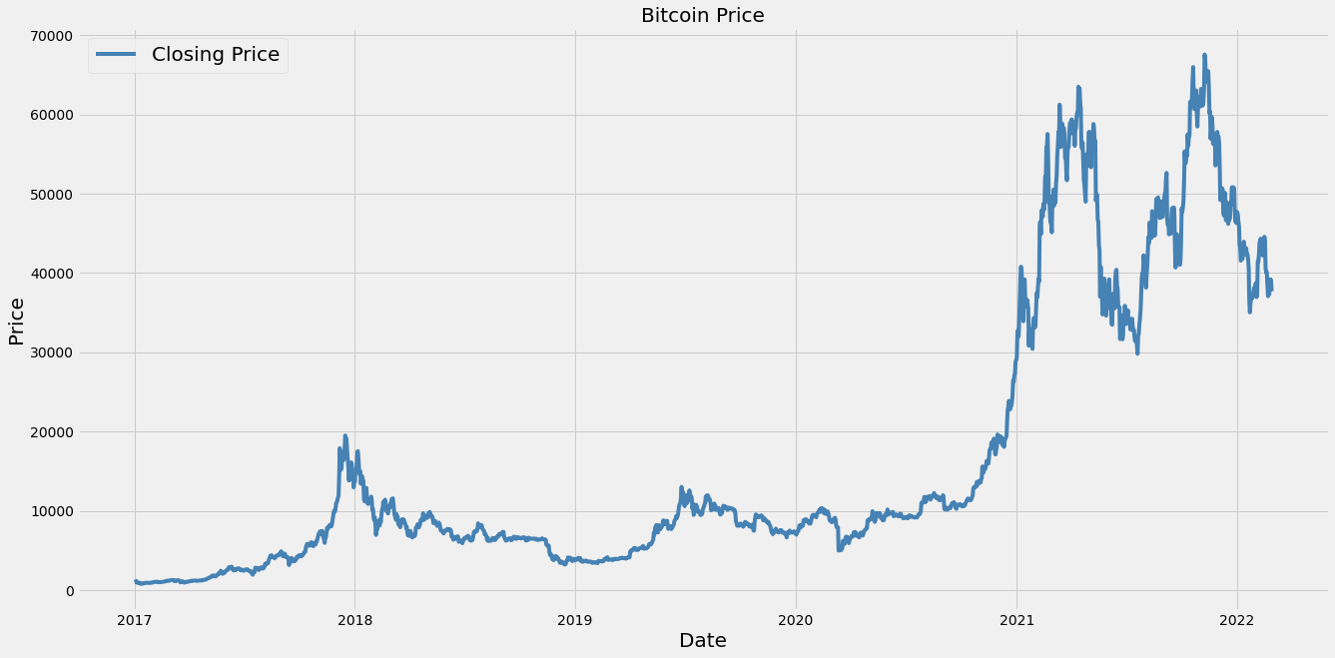
Bitcoin Closing Price Chart (2017)

Slide 7
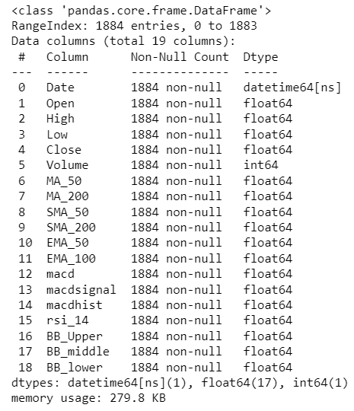
EDA
Imported the data using Yahoo Finance API
The data is from 2017 to 28-02-2022
Consist 1844 rows and 19 columns
Drop the column ‘Dividends’ and Stock Splits

Slide 8
EDA
I add the following Technical indicators (TI)
Moving Average (MA) – 50 days and 200 days
Simple Moving Average – 50 days and 200 days
Exponential Moving Average – 50 days and 100days
I add the following momentum indicators (MI)
Moving Average Convergence Divergence (MACD) – MACD, MACDHIST, MACDSIGNAL
Relative Strength Index (RSI) – 14 days
Bollinger Band (BB) – BB_upper, BB_middle, BB_lower

Slide 9
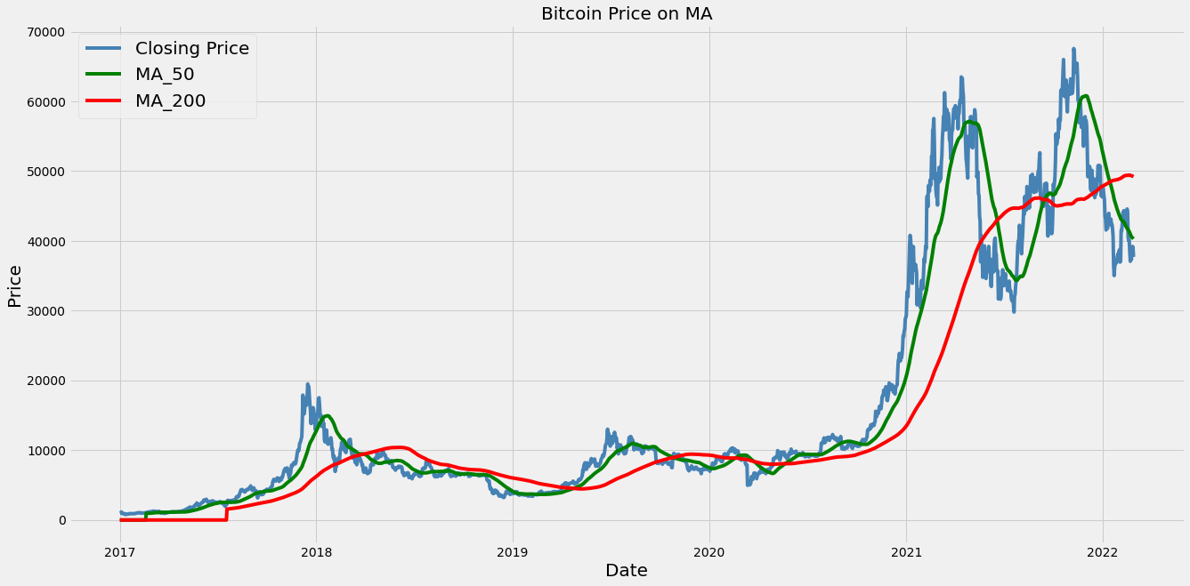
TI – Moving Average (MA)

Slide 10
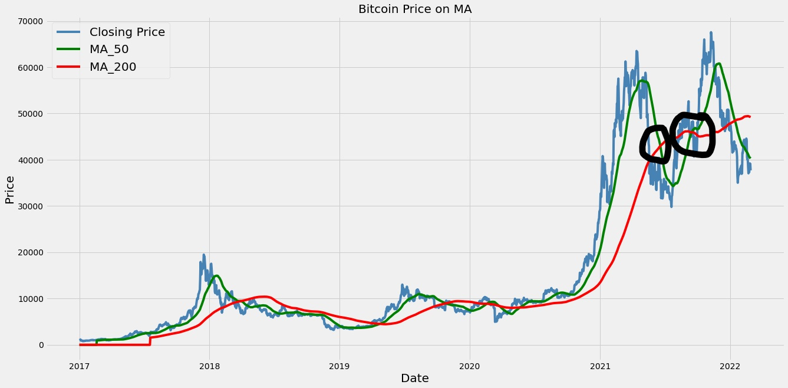
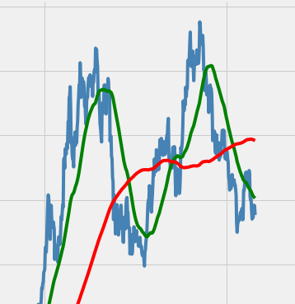
TI – Moving Average (MA)

Slide 11

TI – Simple Moving Average (SMA)

Slide 12
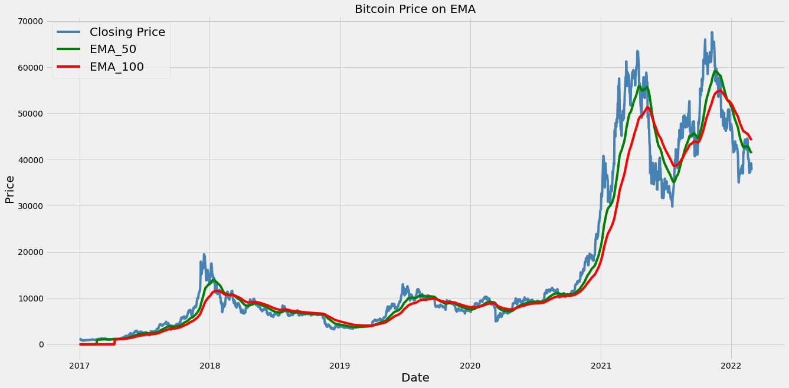
TI – Exponential Moving Average (EMA)

Slide 13
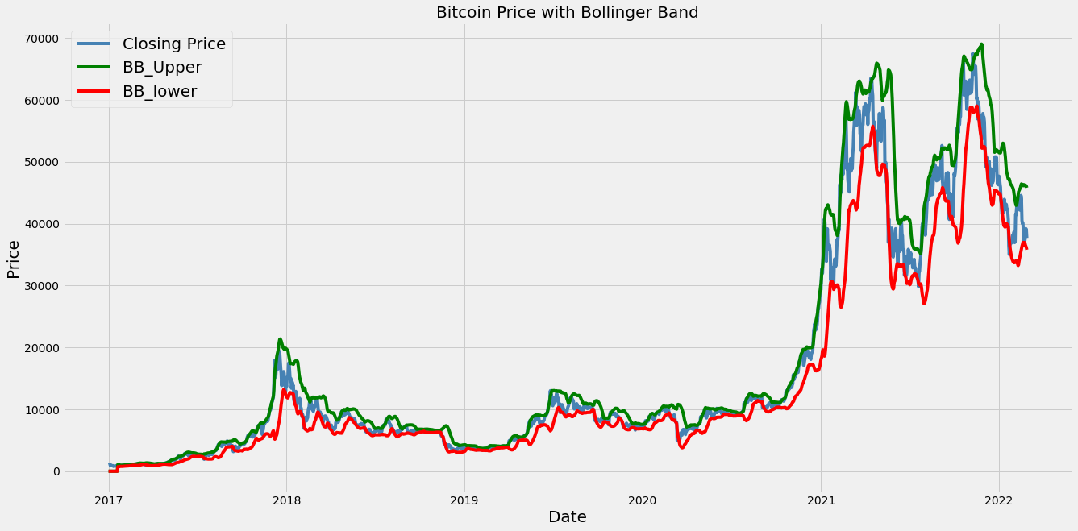
MI – Bollinger Band (BB)

Slide 14
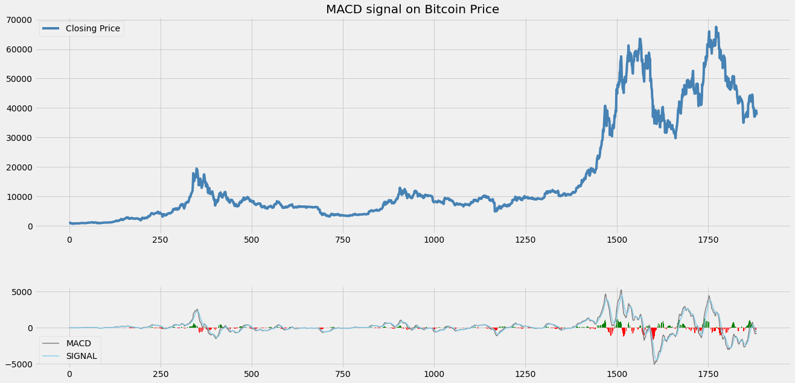
MI – Moving Average Convergence Divergence (MACD)

Slide 15
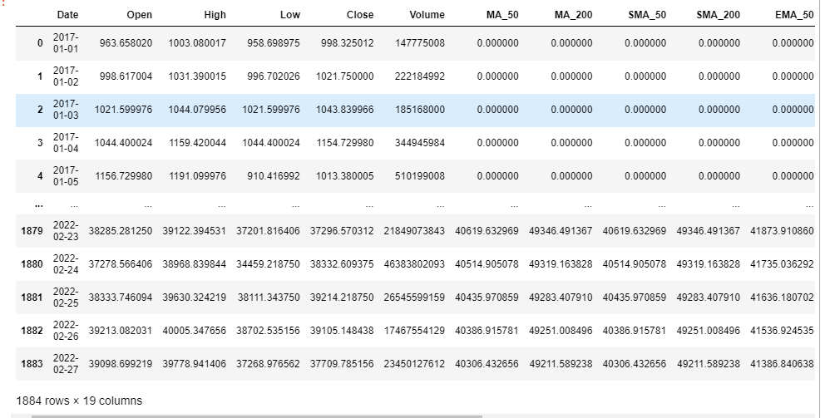
Data Cleaning
When I add the technical indicators, there will be null value in the data.
I did a fillna(0, inplace=True)
There is no Duplicate data

Slide 16
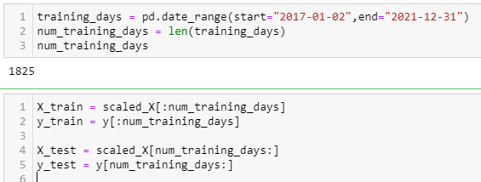
Train Test Split
This is a Time Series data that is recoreded over consistent interval of time
Train my training data from 2017 to 2021 December 31
Test my Test data from 01 January 2022 to 28 February 2022
Use MinMaxScaler to normalize my data

Slide 17
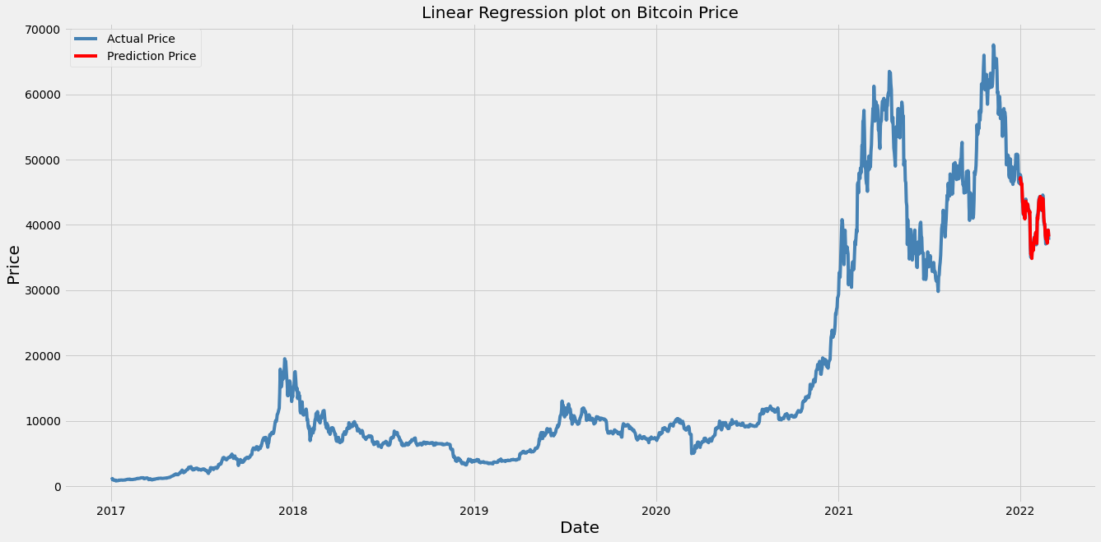
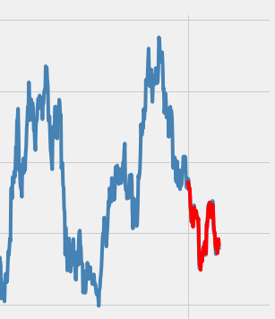
Model – Linear Regression

Slide 18
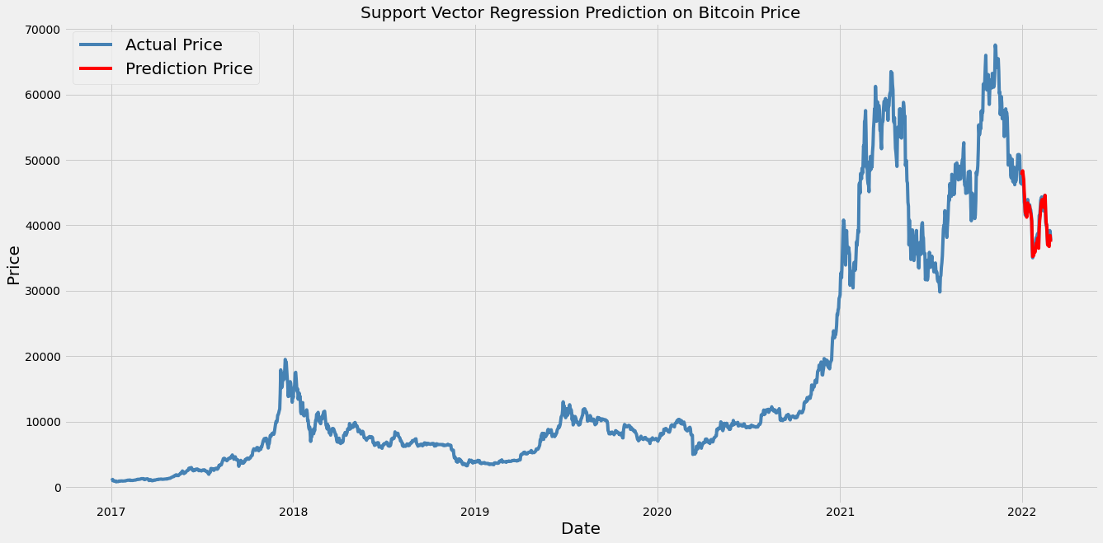
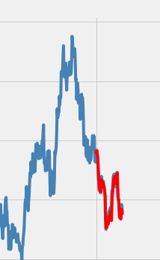
Model - SVR

Slide 19
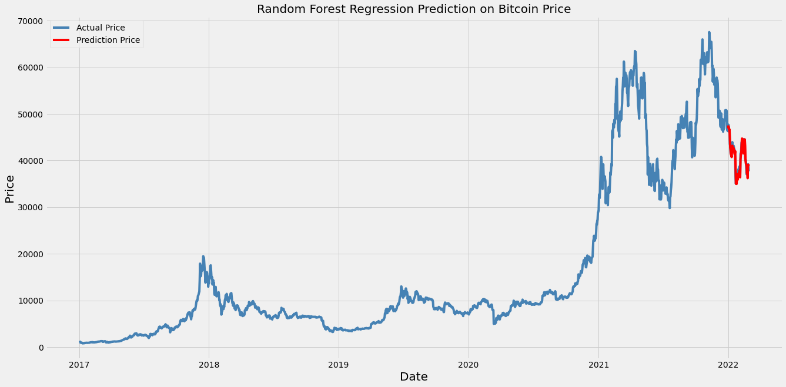
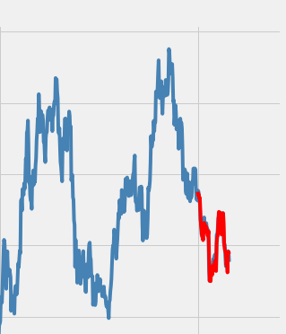
Model – Random Tree Forest

Slide 20
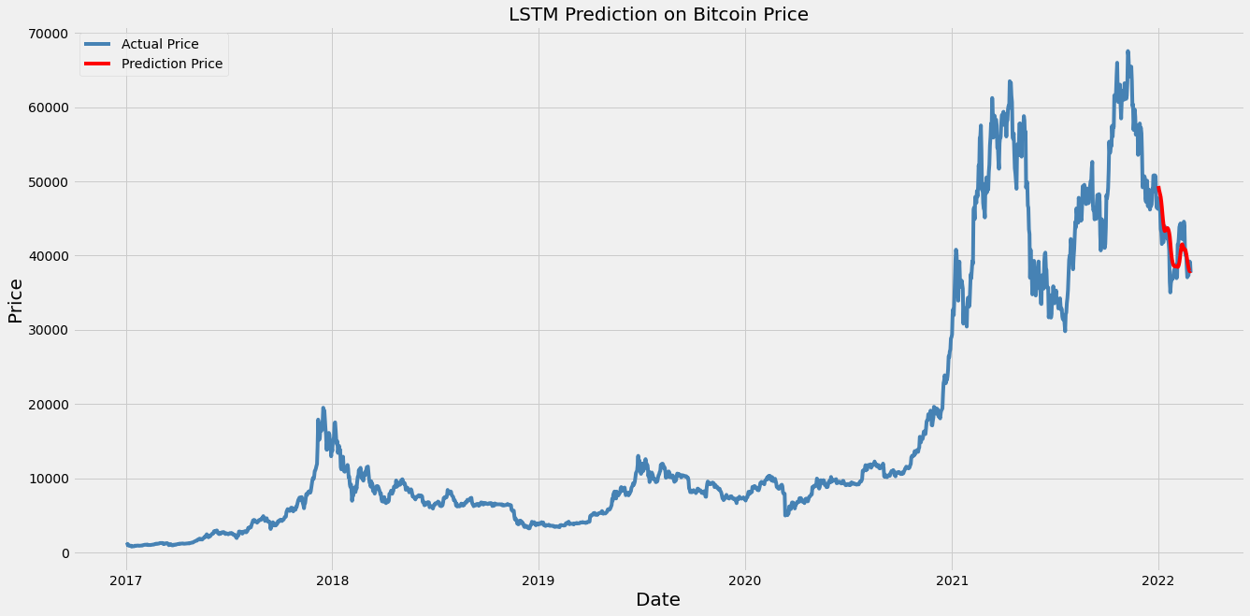
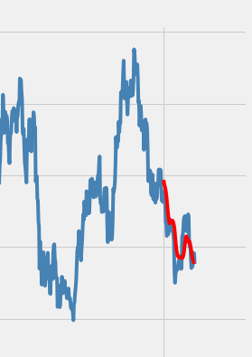
Model - LSTM

Slide 21
Model Evaluation
Model | RMSE | MAE | MAPE
Linear Regression | 557.76 | 430.07 | 0.011
SVR | 827.04 | 430.07 | 0.017
XGBoost regression | 1391.92 | 1194.43 | 0.03
Random Forest | 945.85 | 750.75 | 0.02
LSTM | 0.087 | 0.067 | 3.326
Lower the value the better the model can fit
Base on the model evaluation LSTM perform the best in average for all 3 columns.
I will use LSTM to predict the future bitcoin price 1`

Slide 22
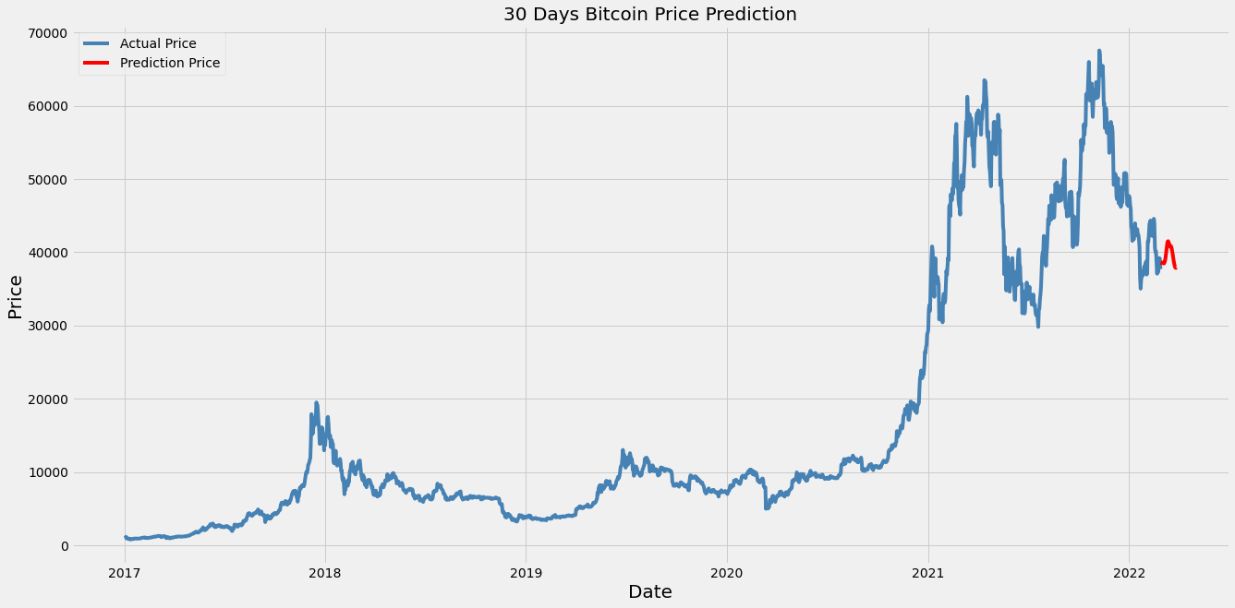
LSTM Prediction
I use the last 30days of dataset to predict the future 30days.

Slide 23
Algorithm Trading using MACD Signal
MACD is a trend-following leading indicator that is calculated by subtracting two EMA
MACD consist of 3 components
MACD - subtracting EMA 12 – EMA 26
MACD_Signal - 9 period of EMA
MACD_Histogram – MACD subtract MACD_Signal
Buying opportunities when MACD is bigger than MACD_Signal and vice versa for Selling opportunities

Slide 24
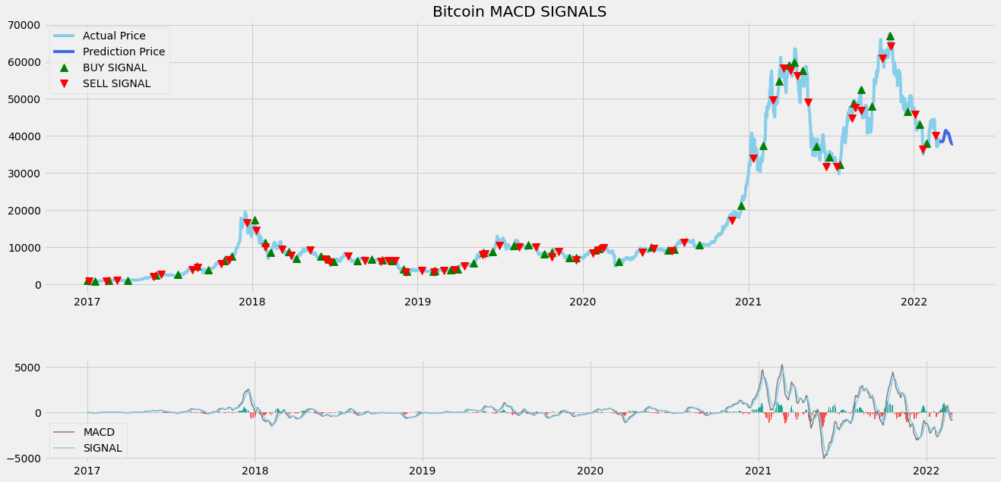
Algorithm Trading using MACD Signal
If I start investing in 2017 with $10 thousand dollar, my return will be $393210.57!

Slide 25
Conclusion
Technical indicator provide some hints bitcoin price might be going downtrend.
The last MACD signal did not indicate any buying opportunity
From the LSTM Chart, I predict that bitcoin may be bearish for the rest of the year in 2022.

Slide 26
Q&A

